Slide 1
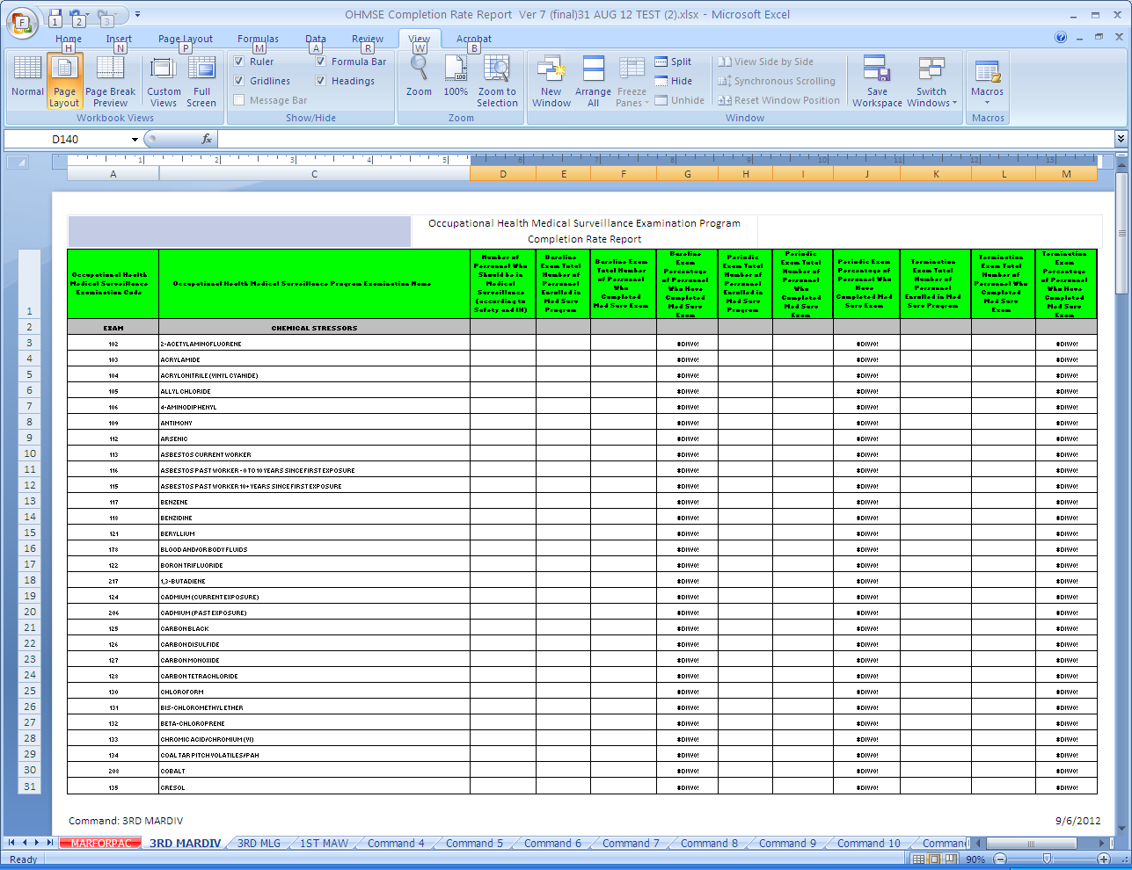
Not all OHMSE programs are required. Most commands
will only have 1-10 OHMSE programs.

Slide 2
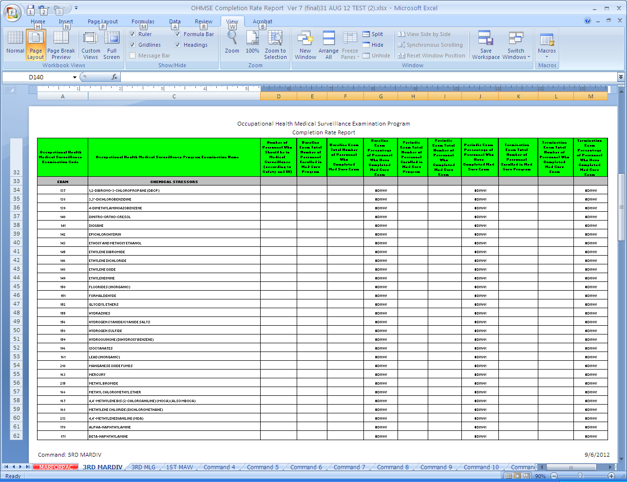
OHMSE exams should be based on the
most current IH survey recommendations.

Slide 3
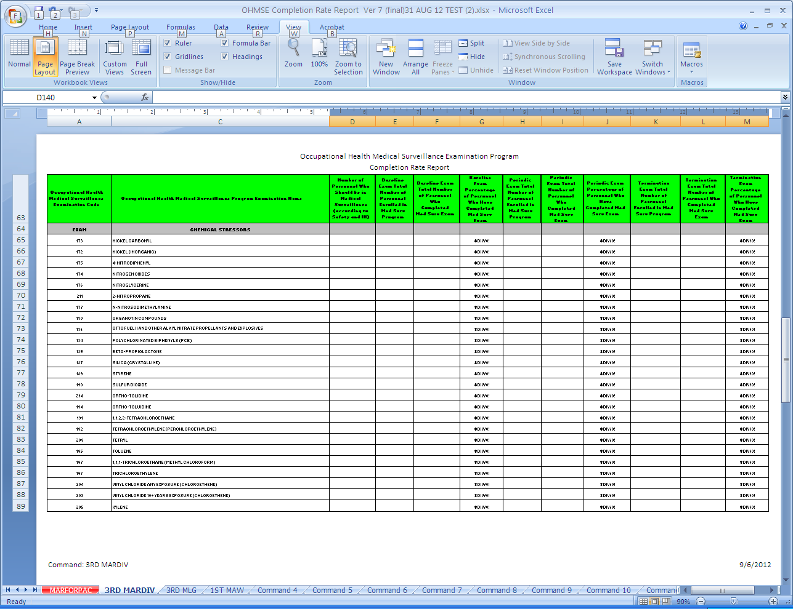

Slide 4
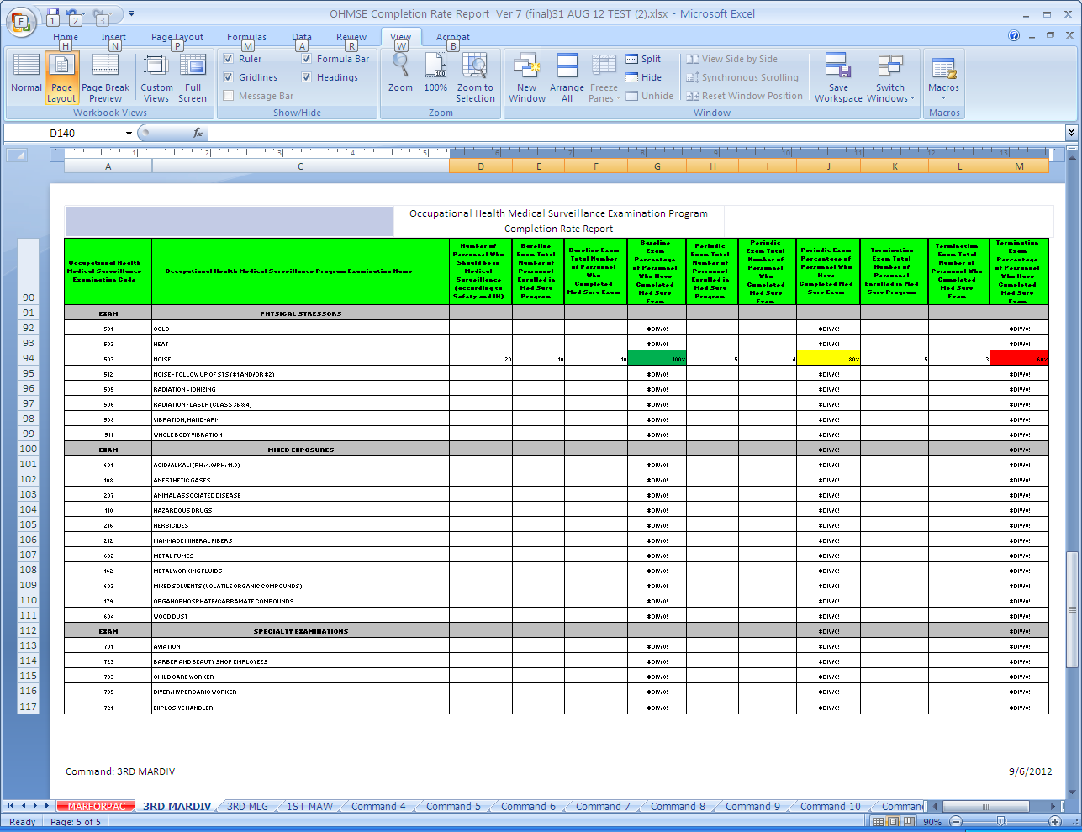
Enter number of personnel who require OHMSE Col D
Enter Number of personnel enrolled who require baseline Col E
Enter number who completed exam Col F
Enter number enrolled and completed
Periodic Col H & I
Enter numbers as in previous section Col K & L
The percentage complete is automatically calculated
for baseline, periodic, and termination exams in Col G, J and M respectively.

Slide 5
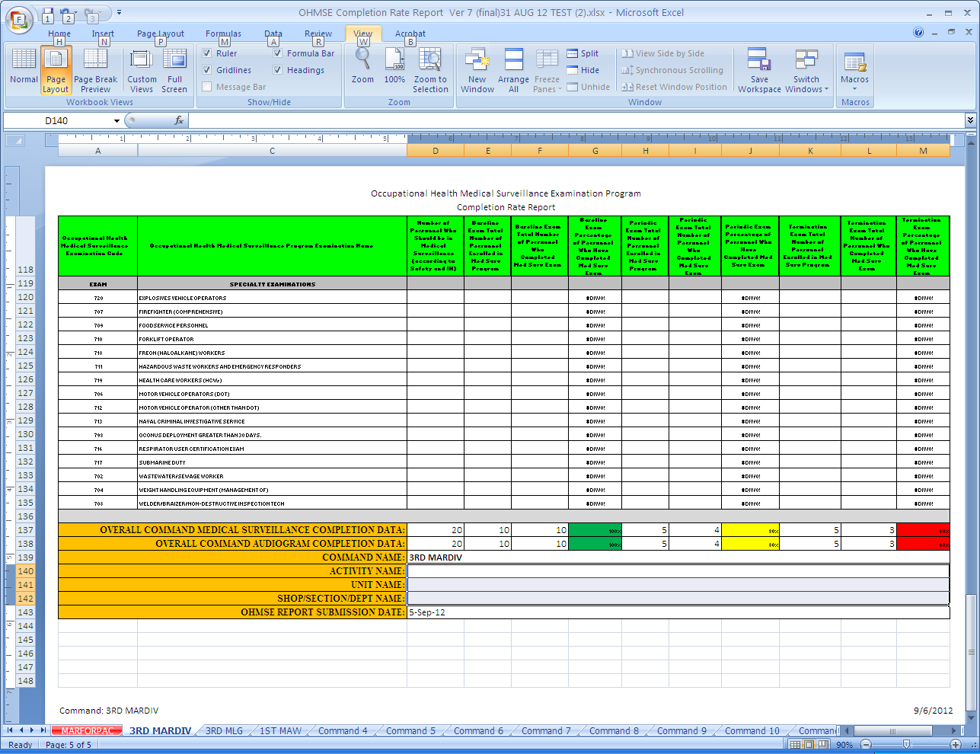
Not all specialty exams are listed in IH Survey.
Contact IH Clinic, Safety, Medical, or Occupational
Health Clinic for guidance

Slide 6
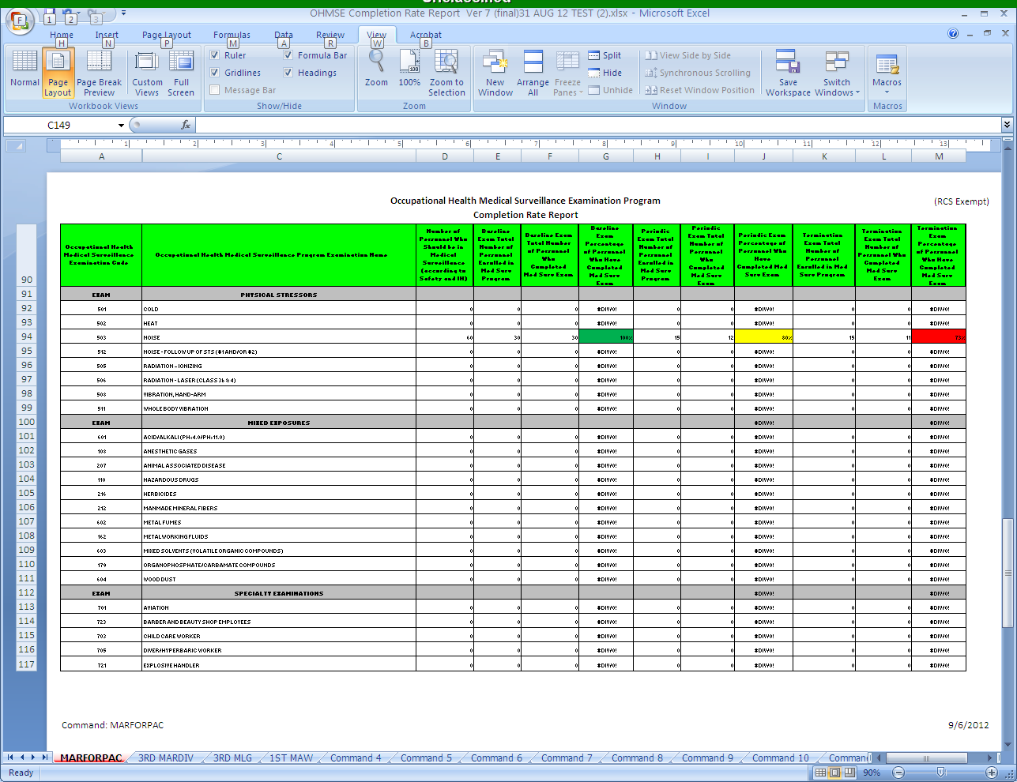

Slide 7
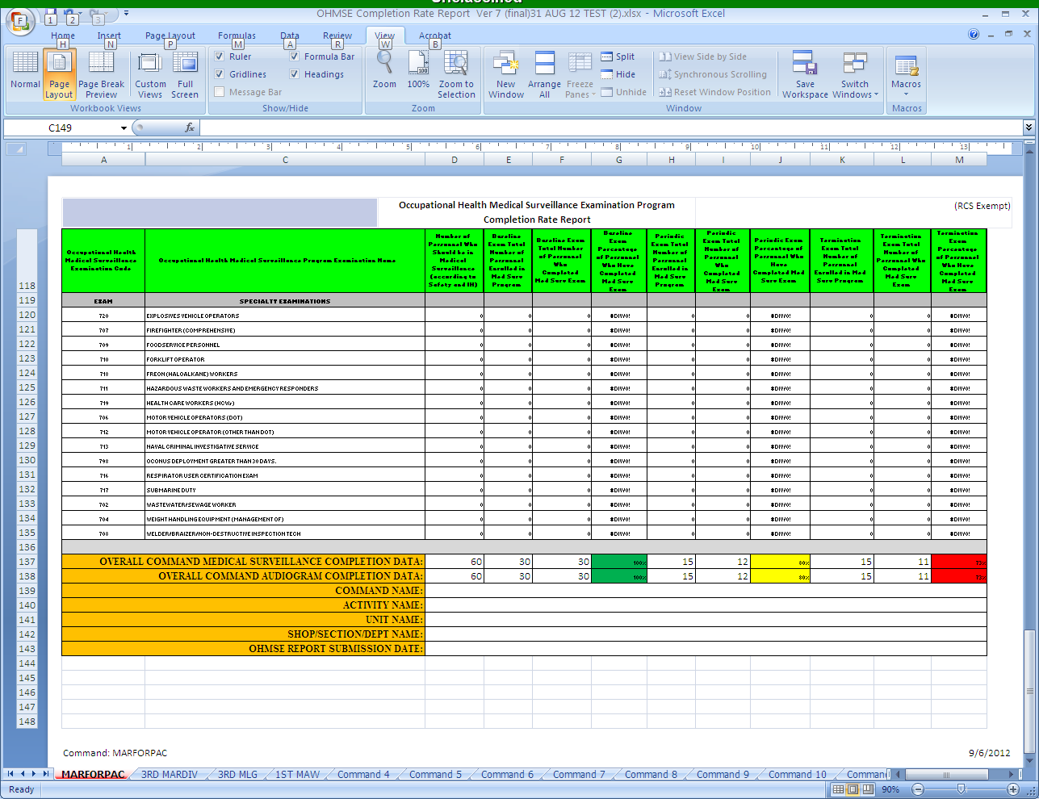
The master sheet will automatically consolidate subordinate commands or work center
completion rates and color code based on percent complete as seen on this sheet and previous .

